Slide 1
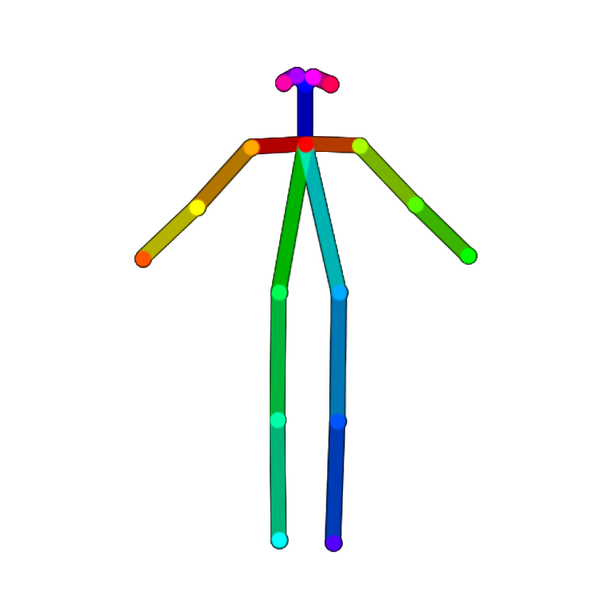
Posture Detection and Correction using OpenPose
Authors: Ally Ryan, Michael Nweke and Parisha Rathod

Slide 2
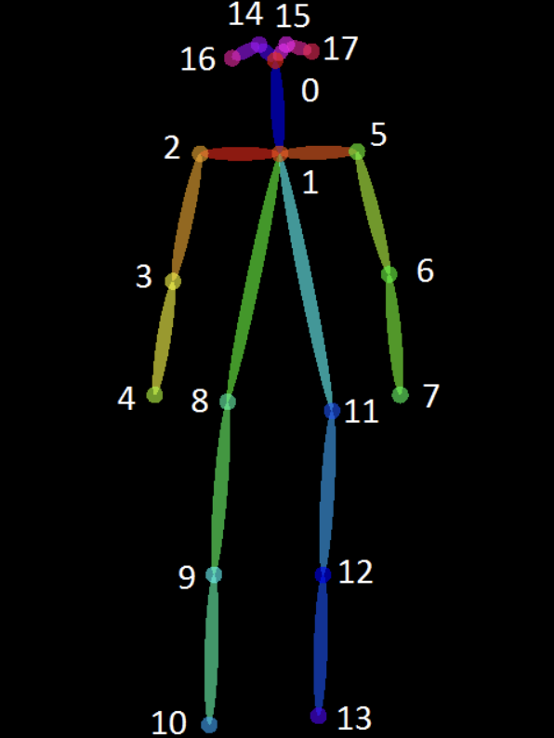
Project Inspiration: Sitting Posture Recognition
MIT Licensed software with source code on GitHub that outputs the sitting position of a person when the lateral view of the person is given as input.
Output determines position of the back (straight, hunchback, reclined), position of the hands (folded vs not folded), and kneeling (i.e., feet curled behind the knees).
Uses a trained Keras model of OpenPose to detect keypoints of the human body, which are used to estimate the sitting posture of the person.

Slide 3

Why this project is important?
Poor sitting posture can cause lower back and neck pain, and various adverse health effects, including imbalances in the musculoskeletal system, balance issues, impaired digestion, and reduced flexibility.

Slide 4

What is considered good seated posture?
Keeping the feet flat on the floor
Avoid crossing the knees or ankles
Place the ankles in front of the knees
Relax the shoulders
Sit up straight and look forward without straining the neck.

Slide 5
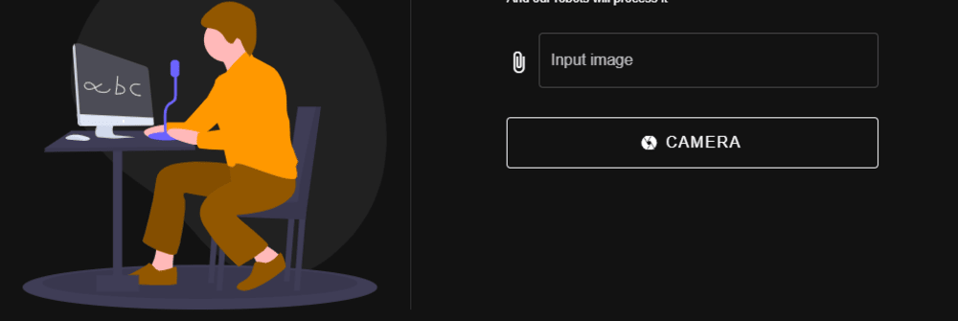
What do we intend to add?
Position of the neck.
Determine if feet are on the ground vs dangling in the air.
Determine if legs are crossed.
Make recommendations for posture improvement that can reduce the change of back and neck pain.
Create an easy-to-use UI that can enables users to easily view their posture status and corresponding recommendations.

Slide 6
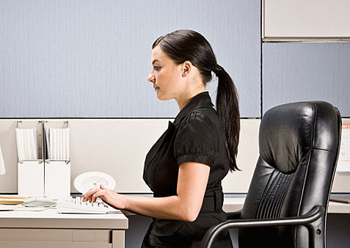
Summary of Expected Outcomes
Design a seated posture assessment interface that evaluates the alignment of the back, feet, knees, and neck, and provides personalized recommendations to minimize the risk of neck and back discomfort.

Slide 7

Frontend: Vue.Js Framework
A JavaScript framework for building user interfaces. It builds on top of standard HTML, CSS, and JavaScript and provides a declarative and component-based programming model that helps you efficiently develop user interfaces, be they simple or complex.

Slide 8

Backend Database: Firebase
Features a suite of services that streamline backend development. Its offerings include Firestore, a real-time NoSQL database capable of storing not only textual data but also multimedia content such as pictures and videos. Additionally, Firebase provides authentication, cloud functions, hosting, and more. The platform is crafted to simplify development workflows, empowering developers to concentrate on UI/UX aspects.

Slide 9
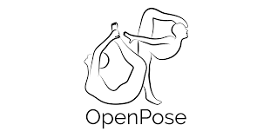
Backend API: OpenPose (Python)
A powerful tool for computer vision and human pose estimation. OpenPose is an open-source library that utilizes deep learning techniques to detect and track key body points, or keypoints, in real-time from images or video frames. These keypoints represent various body parts, such as the head, shoulders, elbows, wrists, hips, knees, and ankles.

Slide 10
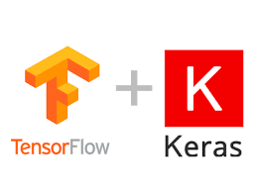
Model: Keras model via OpenPose
This model follows a VGG-like architecture and employs a multi-stage approach (stages 1 to 6) to progressively refine predictions. It focuses on detecting keypoints on the human body, including joints like head, shoulders, elbows, wrists, hips, knees, and ankles.
The architecture includes branches for both Part Affinity Fields (PAF) and confidence maps, and predictions from prior stages are concatenated with the input for iterative refinement.
The model is designed for training with additional inputs such as vector weights and heat weights, utilizing ReLU activation, concatenation, and multiplication operations.

Slide 11
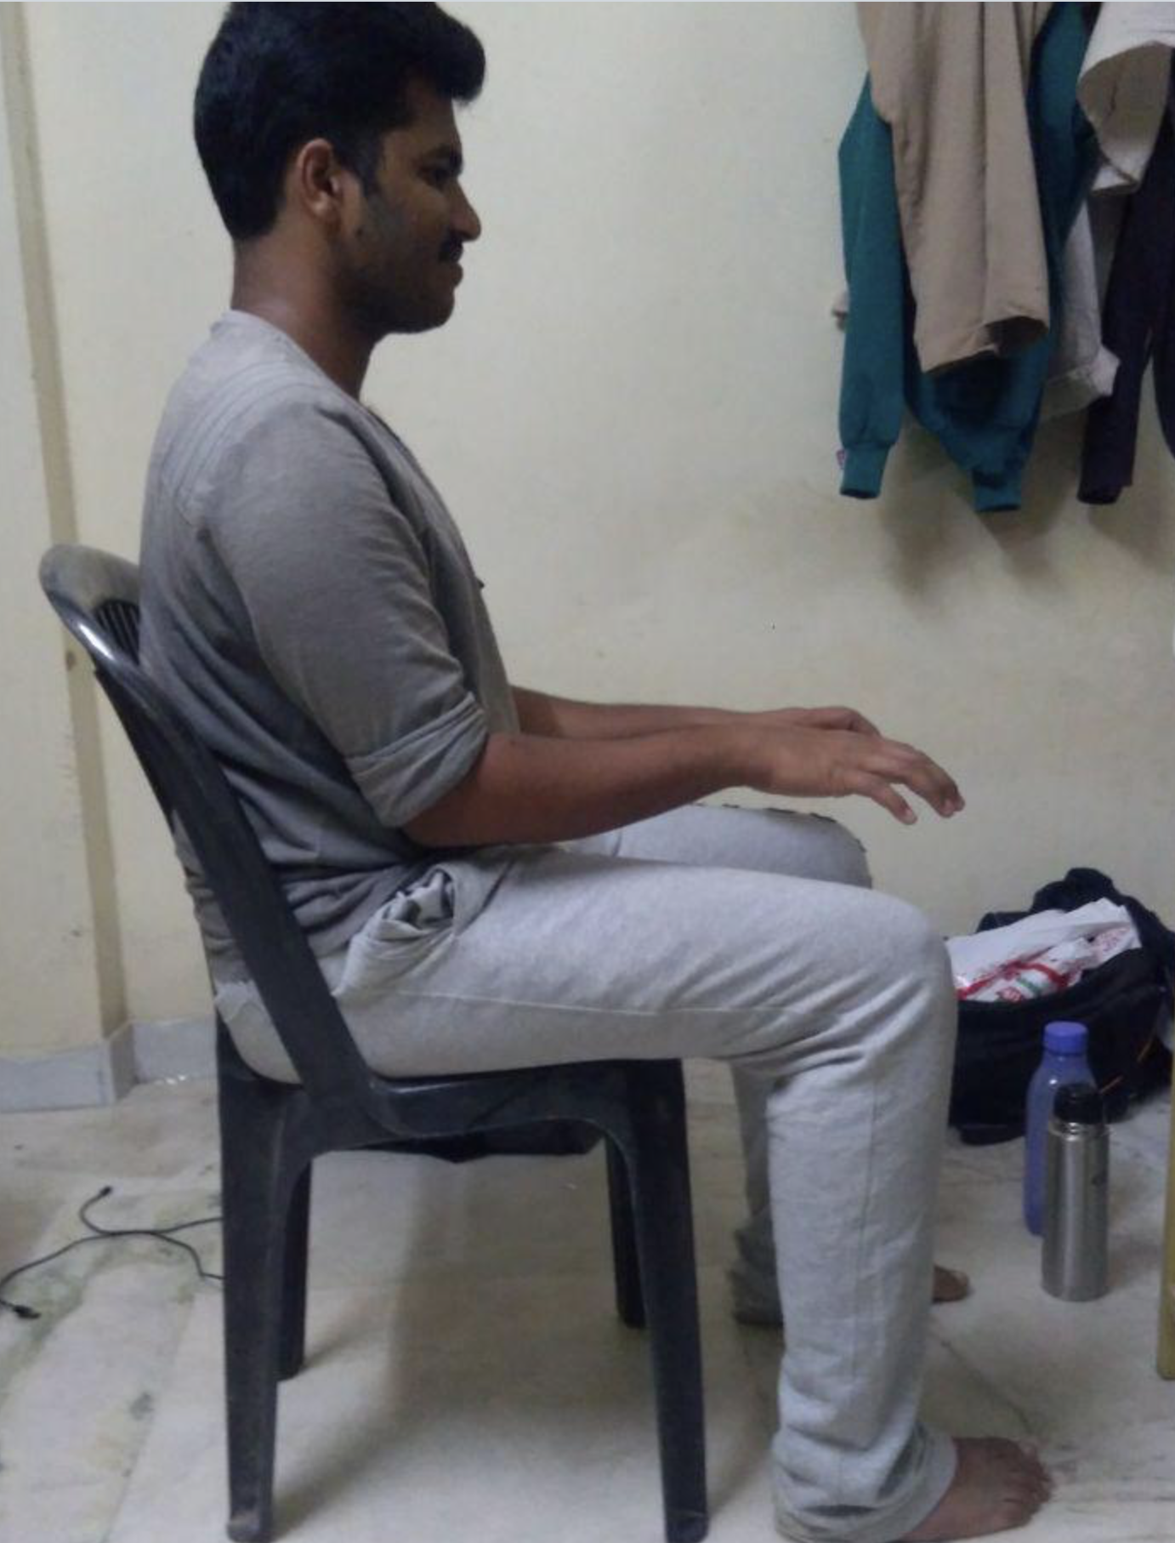
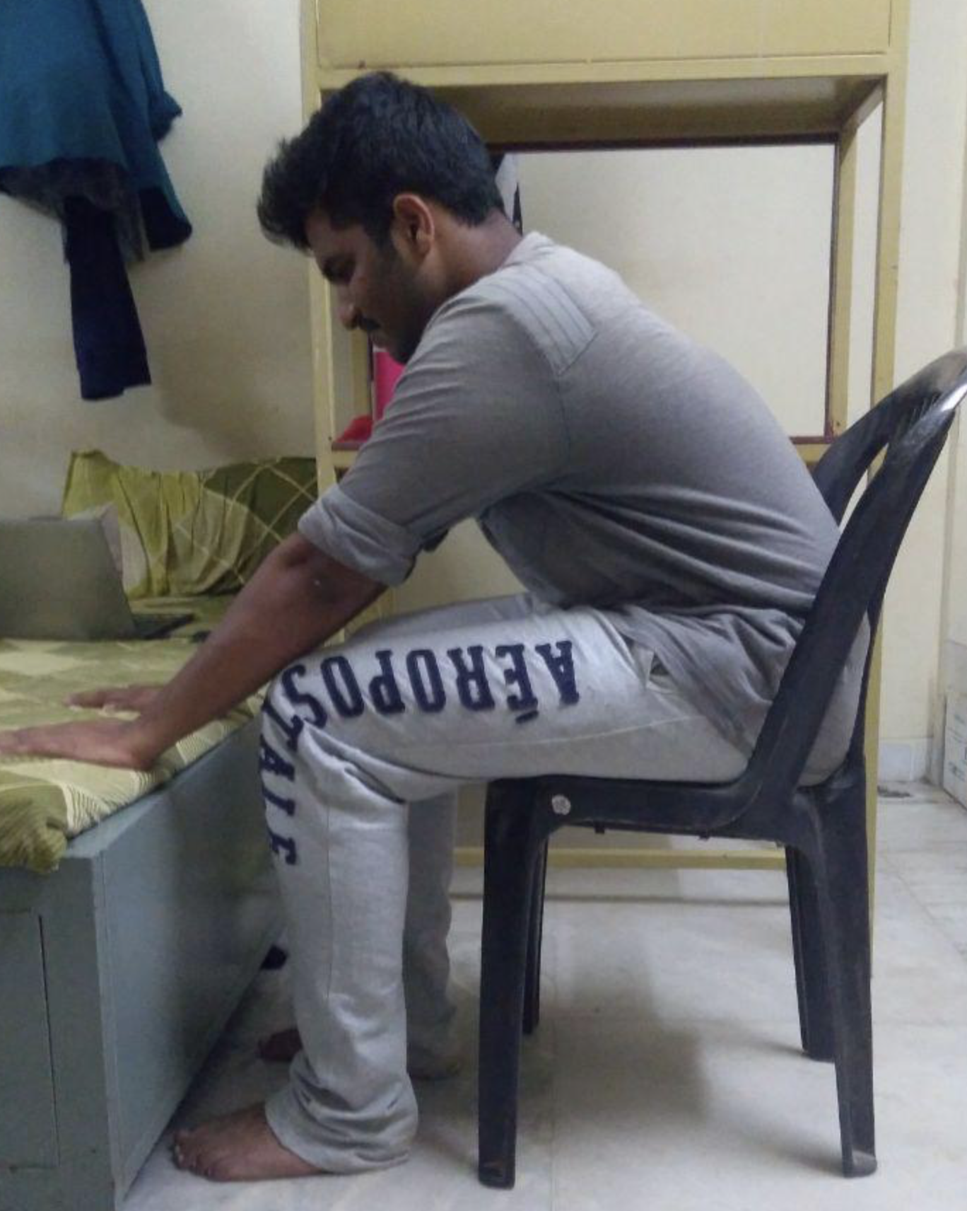
Data Source
Trained Keras Model of OpenPose that already detects keypoints of the body for posture in a seated position
Real Time Testing: We will make our own dataset of 12-14 images of one group member sitting at a desk in different postures.
Bonus: Find large seated posture data set to test.

Slide 12


Slide 13
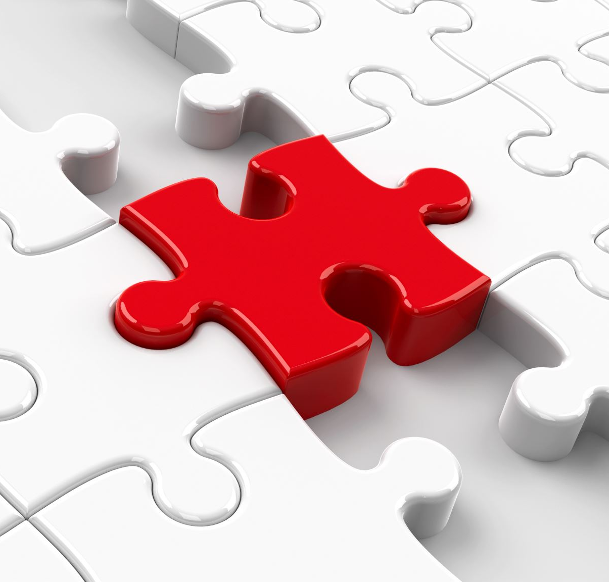
Methodologies: model.py
Defines functions and model architecture using Keras library.
Functions:
Relu: Enhances model’s ability to learn complex patterns by introducing non-linearity and preventing vanishing gradient problem.
Conv: Performs convolution operation on the input tensor with specified parameters like number of filters, kernel size, and weight decay.
Pooling: Implements max pooling operation to downsample the input tensor spatially.
VGG-Block: Constructs a VGG-like block consisting of convolutional layers with ReLU activation and max pooling.
Stage1_block: Defines a block for the first stage of the pose estimation network, comprising multiple convolutional layers tailored for initial keypoint detection.
StageT_block: Defines a block for stages after the first one, containing convolutional layers optimized for refining keypoint estimates.
Apply_mask: Applies a mask to the output of a convolutional block based on the type of keypoint (e.g., PAF or confidence map).
Get_training_model: Constructs a Keras model specifically designed for training the pose estimation network, incorporating the defined blocks and stages.
Get_testing_model: Creates a Keras model suitable for testing the pose estimation system, optimized for efficient inference on new data.
CNN Architecture that includes VGG-like blocks and stages for detecting keypoints and estimating poses.

Slide 14
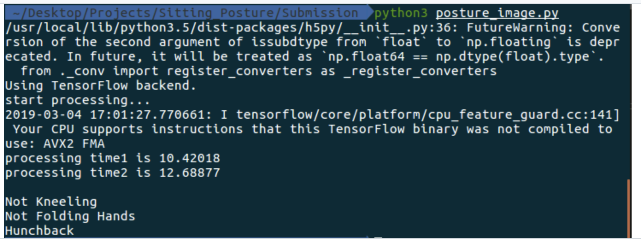
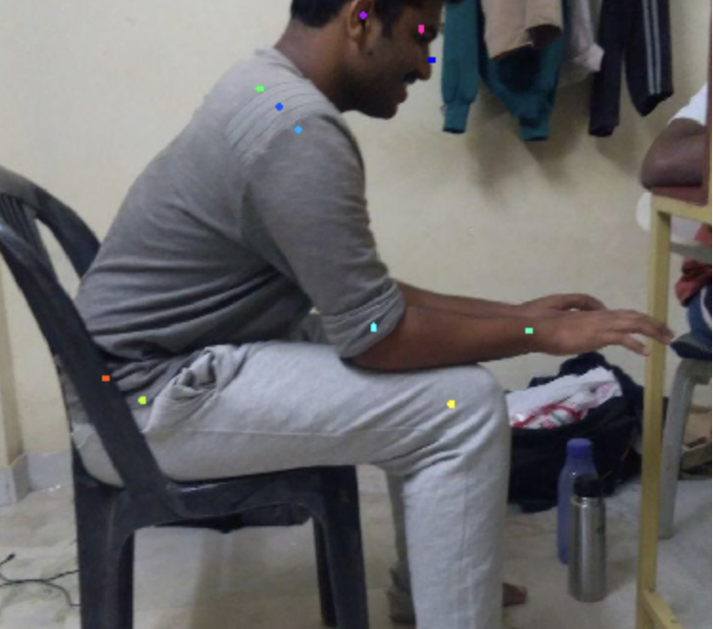
Methodologies: posture_image.py
Utilizes model.py to enable input images to be processed and detect keypoints of the full body using OpenPose
The Process function takes an input image, performs multi-scale inference using the OpenPose, and detects keypoints for each person in the image.
The detected keypoints are then used to check posture positions.
Finally, the processed image with keypoints is displayed.

Slide 15

Further Implementation(Stretch goal): Real-time Object Detection via OpenCV
OpenCV, a versatile computer vision library, stands out in the realm of object detection with deep learning. It offers a rich collection of pre-trained models, including those based on Convolutional Neural Networks (CNNs), making it a robust choice for detecting objects in images and videos. OpenCV's real-time optimization and efficient algorithms enable swift and accurate object recognition, making it particularly suitable for applications where timely identification of objects is crucial. Its ease of integration, diverse set of tools, and established documentation further contribute to OpenCV's prominence in the field of object detection with deep learning.

Slide 16
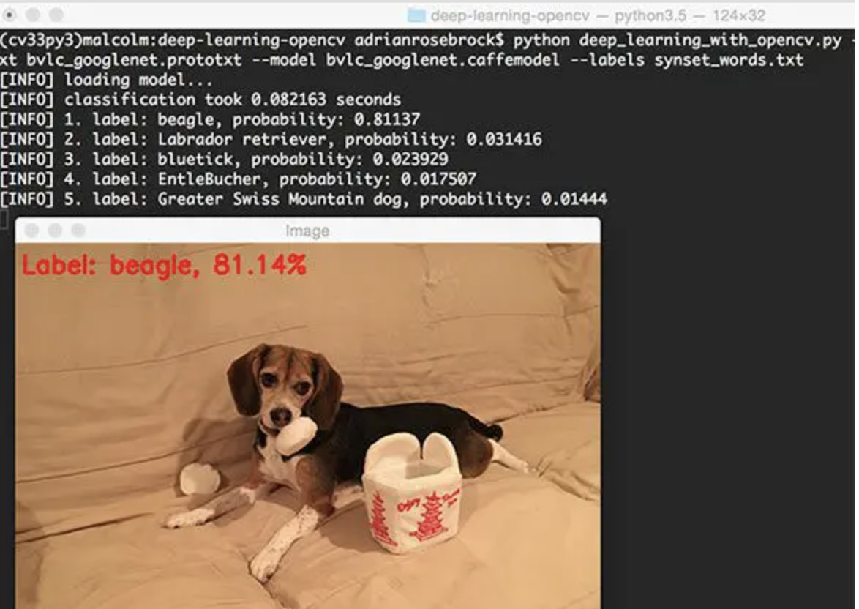
Why is this important?
Model can identify useful objects and can be supplied with domain knowledge for more specific use cases
For example, recognizing dog breeds, detecting different yoga poses, dance moves, etc.

Slide 17
What we’re adding
Not only will this model be able to identify objects but it will be able to discern between dog breeds, different action poses, and different sports.

Slide 18

Important Links
Project repo:
https://github.com/m-nweke/CS5588-Capstone-Project/blob/main/README.md
Examples for reference:
Object Detection Example: https://pyimagesearch.com/2017/08/21/deep-learning-with-opencv/
GitHub Posture Source Code: https://github.com/nvinayvarma189/Sitting-Posture-Recognition/blob/master/README.md

